Slide 1
Python APIs
Tuesday 12/18

Slide 2
Objectives
Understanding APIs
JSON

Slide 3
API Diagram Scenario: User wants some data from a web application
API
1. Client makes request for data against API
3. API sends requested data in a response
2. API handles request by retrieving requested data from application servers/databases
Client
Server
Notes:
User icon: https://static.thenounproject.com/png/17201-200.png
API icon: https://d30y9cdsu7xlg0.cloudfront.net/png/38239-200.png
Server icon: https://png.pngtree.com/svg/20161113/server_30008.png

Slide 4
REST API calls

Slide 5
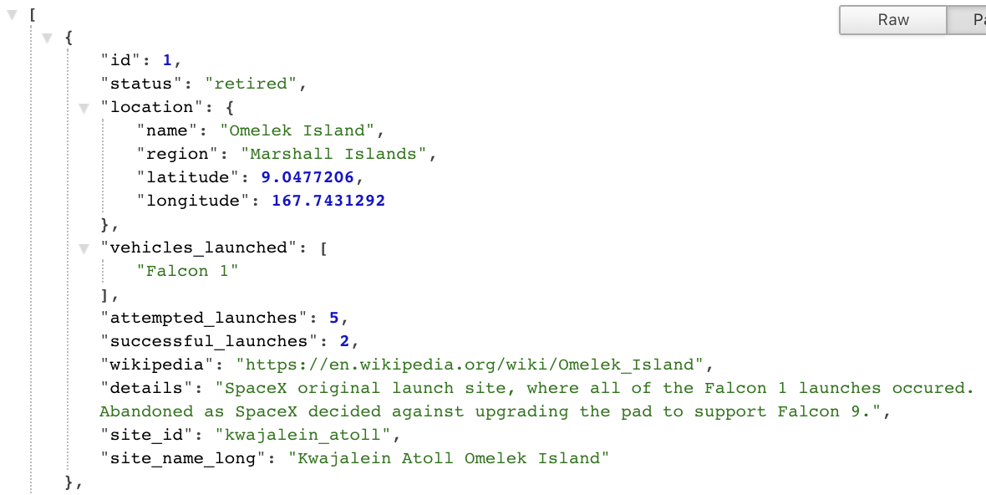
JSON (JavaScript Object Notation)
Language-independent, text-based data format that is oftentimes the default data format used for API communication.
Follows key:value structure similar to Python dictionaries
Can easily be converted to familiar Python objects
Example using https://api.spacexdata.com/v3/launchpads
NOTE: I suggest installing the JSON Formatter Chrome extension, for easy parsing.

